Slide 1
Mid Term Presentation
Team 1 : Bon Appetit
Presented By :
Manoj Gopisetty
Priyanka Galla
Vijaya Raja Mayuri Akula
Nikitha Mandala

Slide 2
Team Slide
Priyanka Galla
Naga Sai Manoj Goppisetty
Nithya Vudayamarri
Nikitha Mandala
Lahari Thamatam
Vijaya Raja Mayuri Akula
Harshavardhan Reddy Bollam

Slide 3
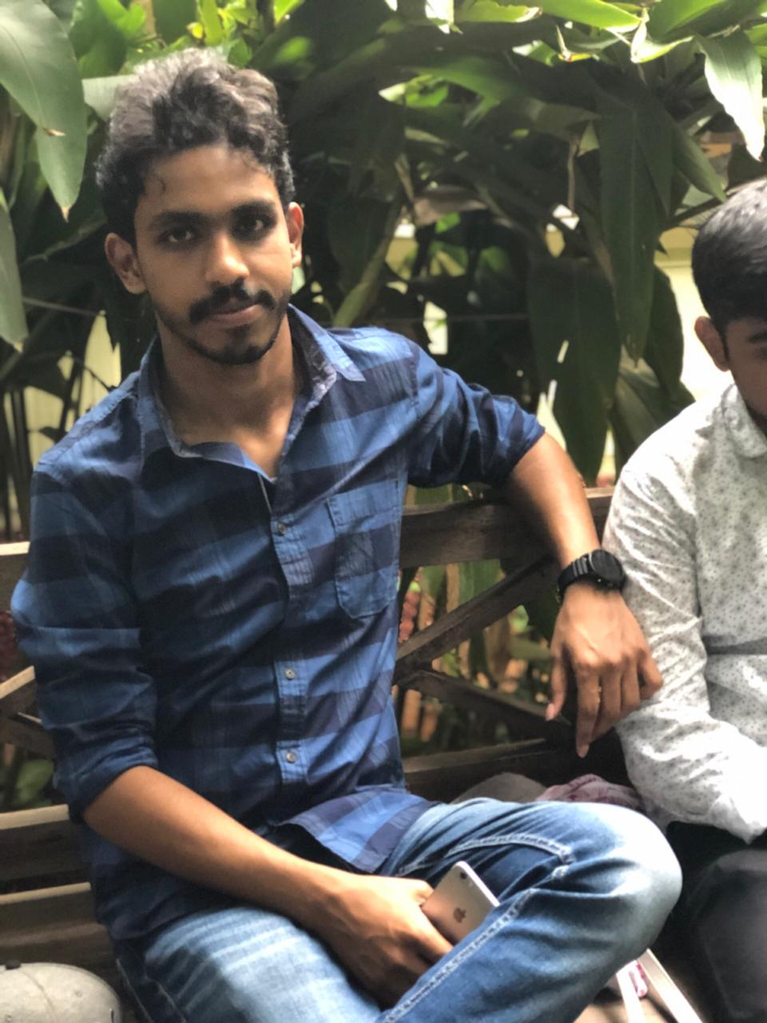
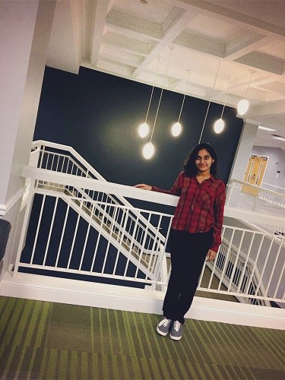

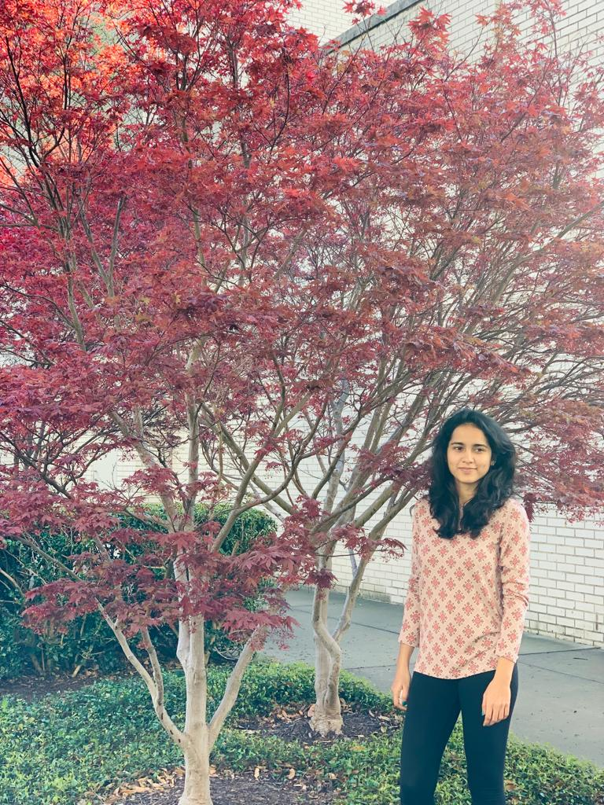
Team Members
Naga Sai Manoj Goppisetty
Priyanka Galla
Vijaya Raja Mayuri
Nikitha Mandala

Slide 4
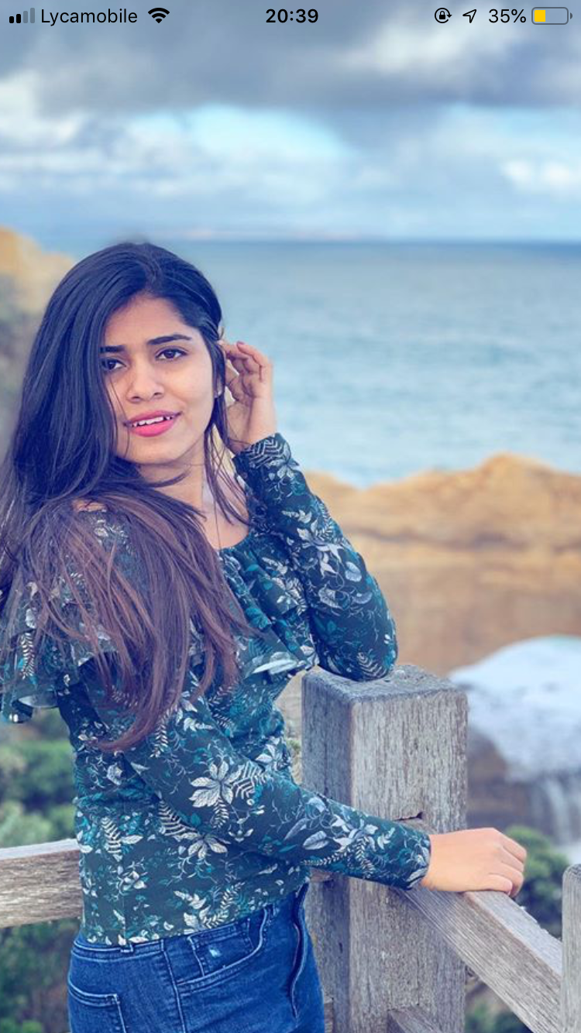
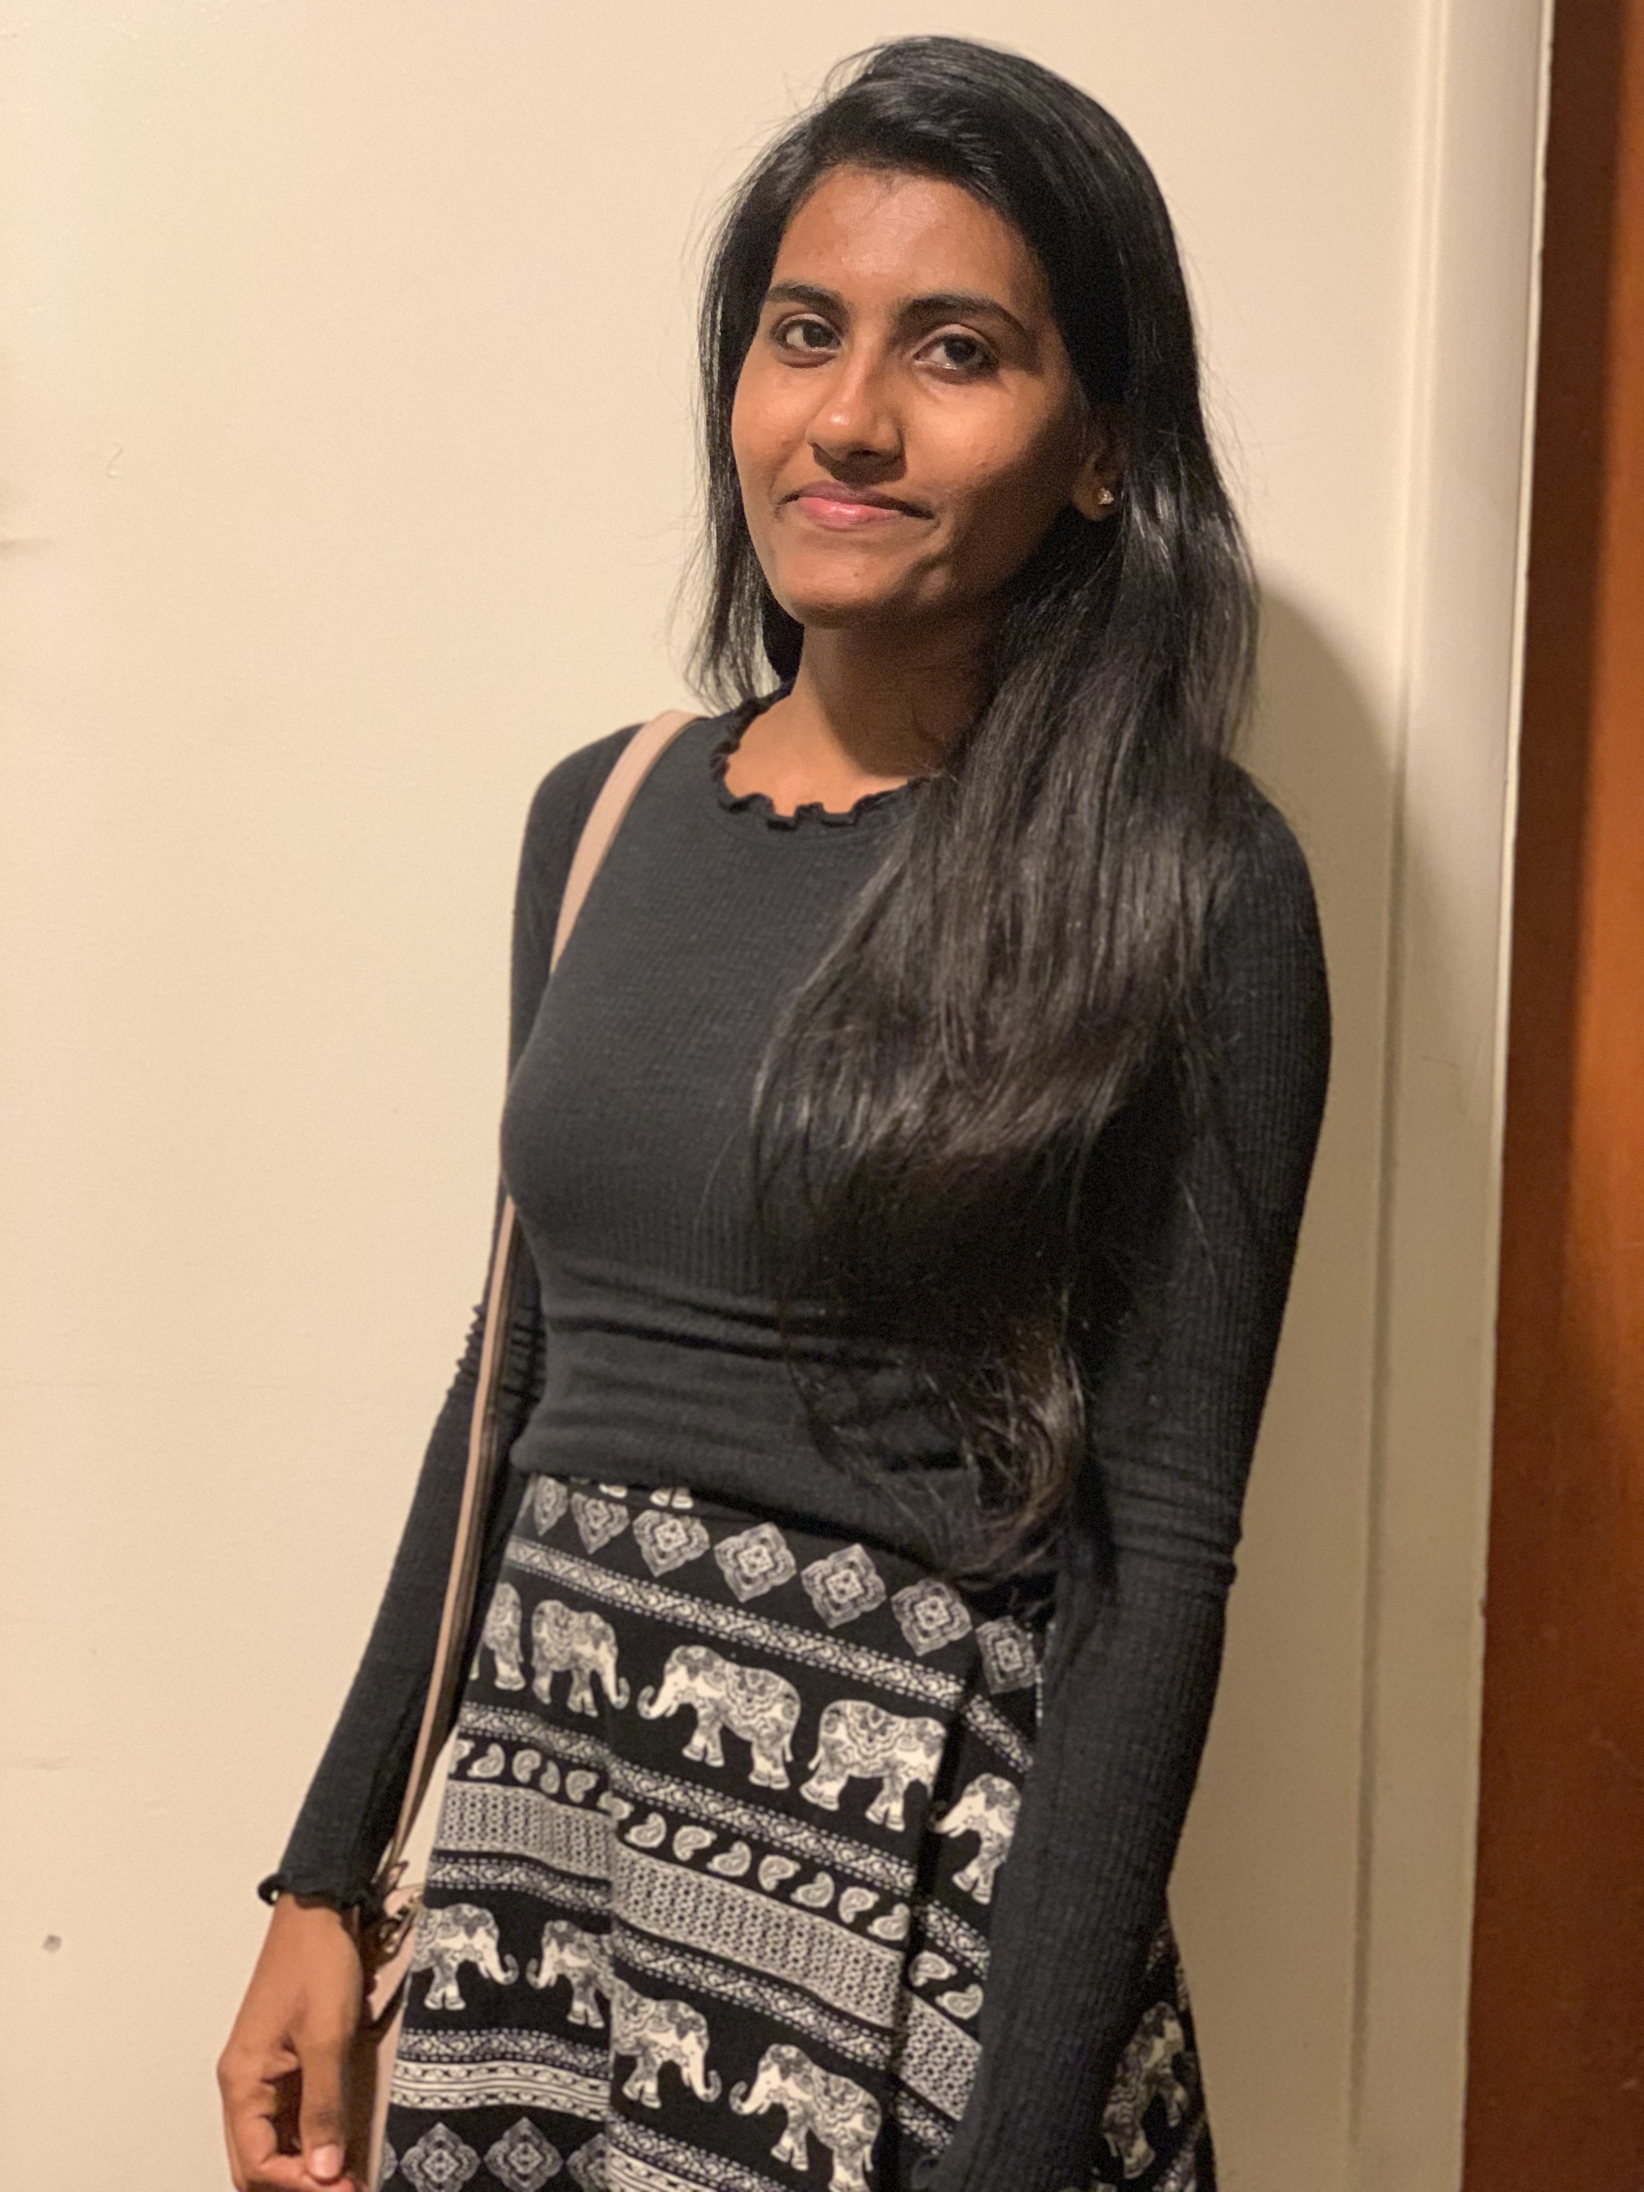

Team Members
Nithya Vudayamarri
Lahari Thamatam
Harshavardhan Reddy Bollam

Slide 5
Contents
Introduction to our Project
Description
Scope
Requirements
Use case diagram
Design
Implementation
Demo
Conclusion
Vijaya Raja Mayuri

Slide 6

Introduction
Bon Appetit is an application that provides food delivery to the doorstep from users’ favourite restaurants nearby.
It allows the users to place food orders from the desired restaurants in certain radius.
It can be downloaded for free!
Vijaya Raja Mayuri

Slide 7

Description
Purpose
Scope
Overview
Vijaya Raja Mayuri

Slide 8
Scope
The website
Allows all the users to view all the available restaurants and menus.
Users may or may not have an account.
Shows all the registered restaurants within 5 miles from users location.
Vijaya Raja Mayuri

Slide 9
Non- Functional Requirements
Performance
Reliability
Availability
Security
portability
Vijaya Raja Mayuri

Slide 10
Functional Requirements
The website has
A Login page
A Signup page
An About Us
A feature to search and select from the registered restaurants
A Menu for each restaurant
A page in which we can add/remove items to/from order
A Payment page
Nikitha

Slide 11
Functional Requirements(contd...)
The website
Maintains ratings and reviews
Offers promotional codes on certain orders
Maintains order history for each user
Nikitha

Slide 12
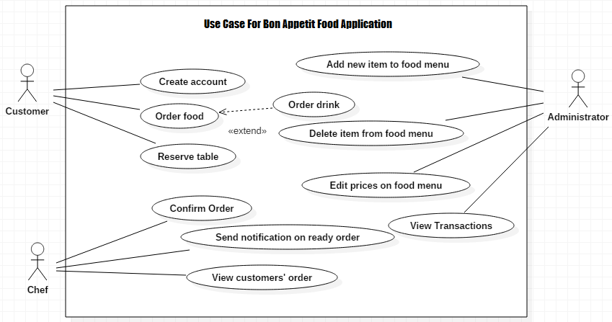
Use case diagram
Nikitha

Slide 13
User Interface
A good user interface provides a "user-friendly" experience.
GUI of our software program includes many user-friendly controls like
1. A Menu Bar
2. Input Selector
3. Images
4. Buttons, etc.
Nikitha

Slide 14
Hardware Interfaces
This application is based on Web Development.
Pentium Processor
60 MB of free hard-drive space
128 MB of RAM
Nikitha

Slide 15
Software Interface
Operating System: Windows (Vista/7 or above)
Web Browser: IE 10 or above, Mozilla FF 31 and above or Google Chrome
Database used: MongoDB
Drivers: Java Runtime Environment
Integrated Development Environment: Eclipse J2EE or Apache Tomcat
Manoj

Slide 16
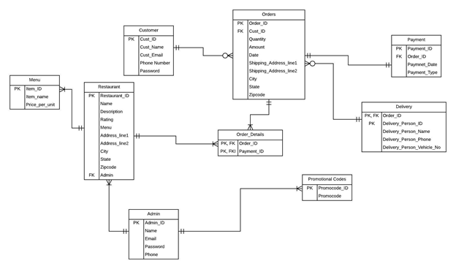
Design – ER Diagram
Manoj

Slide 17
Design Analysis
Relationship between entities
Customer: Orders - 1: M
Orders: Payment - 1: 1
Orders: Delivery - 1: 1
Orders: Order_details - 1: M
Restaurant: Order_details - 1: M
Orders: Promo codes - 1:1
Restaurant: Admin - 1: M
Admin: Promo codes - 1: M
Manoj

Slide 18
Home screen
Home screen contains the menu bar and random restaurants nearby.
Manoj

Slide 19
Login Page
User have to register or login into the application to move further.
Manoj

Slide 20
Sign Up Page
User can create an account using this page.
Manoj

Slide 21
Future work
Contact Page
Restaurant Page
Orders Page
Payment Page
Order Confirmation Page
Ratings & Reviews Page
Reservation Page
Manoj

Slide 22
Demo
Priyanka Galla

Slide 23
Any Questions?

Slide 24


